Slide 1

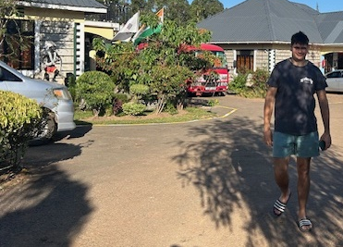
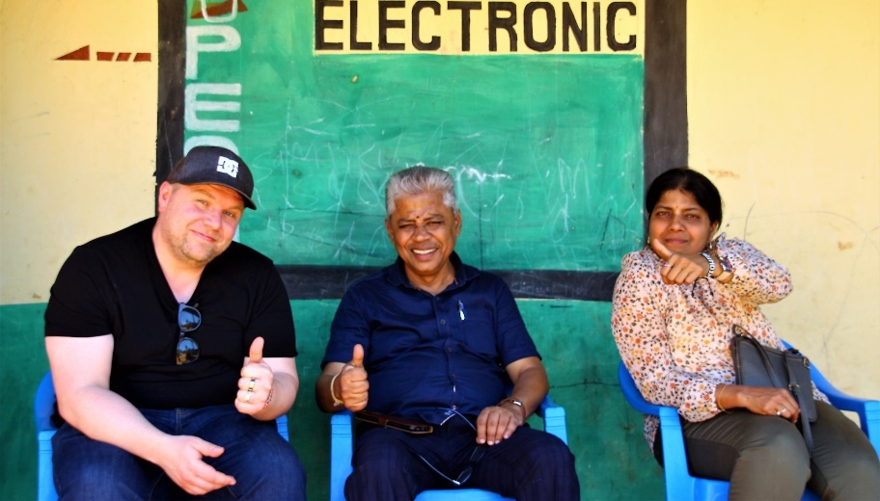
Volunteering Student Exchange Program
Discover. Empower. Make an Impact in Kenya
Manuela Pastore, January 2026 (status) – SCN Kenya, international coordinator/advisor

Slide 2
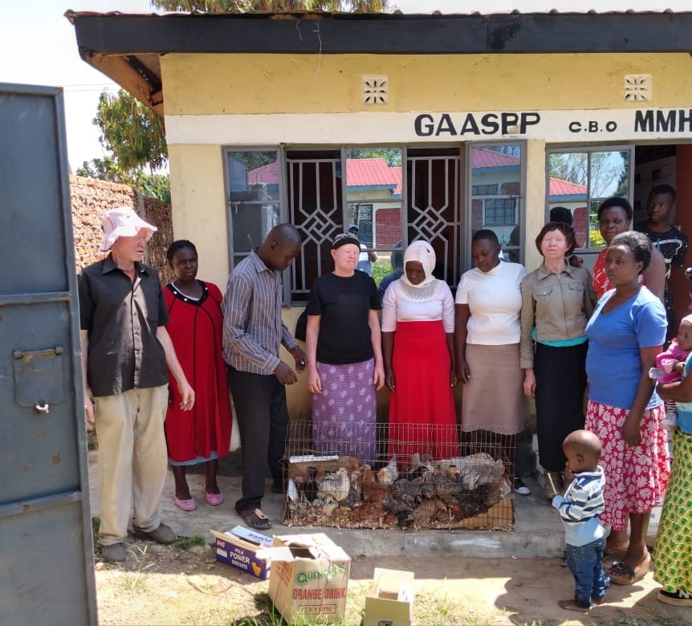
Table of Contents
Program overview 1 & 2
Your NGO, Your Network—Join Kenya’s Movement for Change
Where you can volunteer
Impressions from our NGO centers in the SCN Kenya
Accommodation
Typical daily tasks
How to Propose a New Project Idea
Possible project topics
Costs
Safety, Support & House rules
University contacts
Internship Certificate
How to apply
Program timeline
Organisational details
Contact/Info

Slide 3
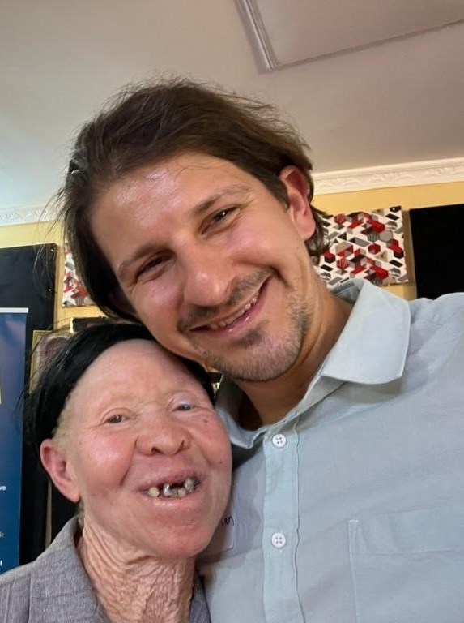
SCN Kenya Student Exchange Program overview, 1
This program empowers students to make a meaningful difference by engaging in practical, holistic community work with individuals living at the poverty line in Kenya.
Through hands-on internships with two respected NGOs—GAASPP (Golden Aged And Albinism Support And Protection Programme) and CHW International (Core Health and Wealth International)—participants actively contribute to systemic change, improved health, local income generation and sustainable agriculture/environment and education in Bungoma County (Western Kenya).
The flexible internship placements (one to six months) allow students to tailor their experience to their academic needs and personal interests, whether participating individually or in small groups.
The program is designed to foster intercultural exchange, practical learning, and social responsibility.

Slide 4
SCN Kenya Student Exchange Program overview, 2
Accommodation is provided in comfortable guesthouses managed by GAASPP and CHW, with three nutritious meals served daily.
Weekends are typically free, giving students time to rest, explore, or further connect with the local culture.
Participants will work alongside local professionals and community members, contributing to impactful projects while developing key skills in project management, teamwork, and cross-cultural communication.
Both NGOs maintain active partnerships with local universities, enabling students to network, collaborate and engage with Kenyan students and faculty.
International students have the opportunity to visit other NGOs within the SCN Kenya network, explore local culture, and participate in excursions such as safari park visits (additional costs apply).

Slide 5

Your NGO, Your Network - Join Kenya’s Movement for Change
Become Part of a Network Driving Real Change
Join the Sustainable Collaboration Network Kenya (SCN Kenya), a vibrant alliance of local NGOs and international partners. Your exchange is anchored by 5 of seven core NGO organizations—connecting you to the entire network.
Founded in 2022, SCN Kenya empowers vulnerable communities across Kenya, especially those at or below the poverty line. The network supports about 500,000 people from Nairobi’s informal settlements to Lake Victoria.
SCN Kenya thrives on partnerships (SDG 17), innovation, and transforming global ideas into local solutions. Through teamwork, creative problem-solving, and social entrepreneurship, you’ll help drive sustainable, community-rooted development.
Join us to learn, grow, and help shape new solutions to big challenges.
Ready to be part of a movement that matters? https://www.scn-kenya.org

Slide 6
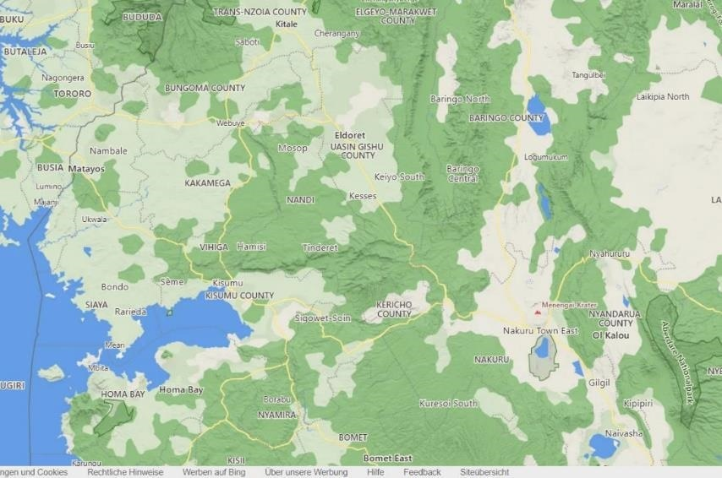
Where you can volunteer?
CHW,
Tongaren
Depending on your interest, we offer 5 NGO core partners in Western Kenya who can host you:
Core Health & Wealth (CHW)
Golden Aged and Albinism support project program (GAASPP)
Solasa
Wa-Wa Kenya
Tendo
(For more details see organisational part)
Ca. 57 km,
By car ca 70 min
Airport,
Eldoret
Solasa,
Eldoret
GAASPP,
Webuye
Tendo,
Kendubay
Airport Kisumu
Wa-Wa Kenya , Homabay
-> Nairobi

Slide 7
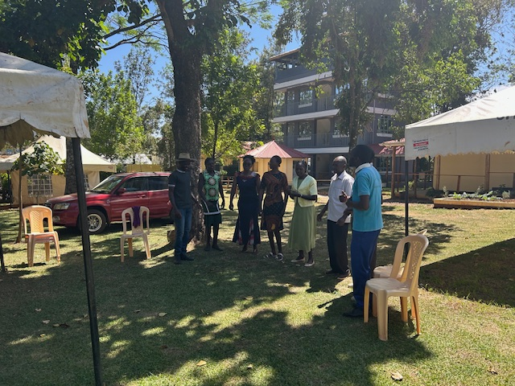
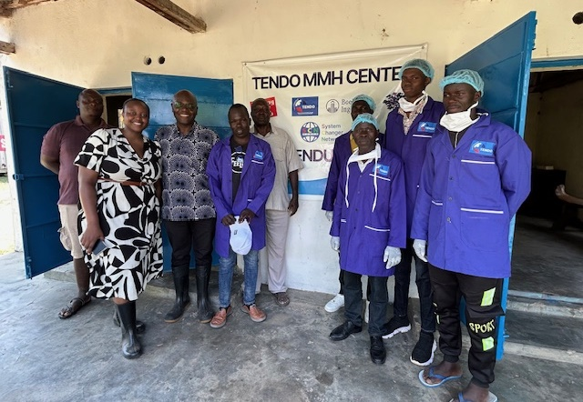
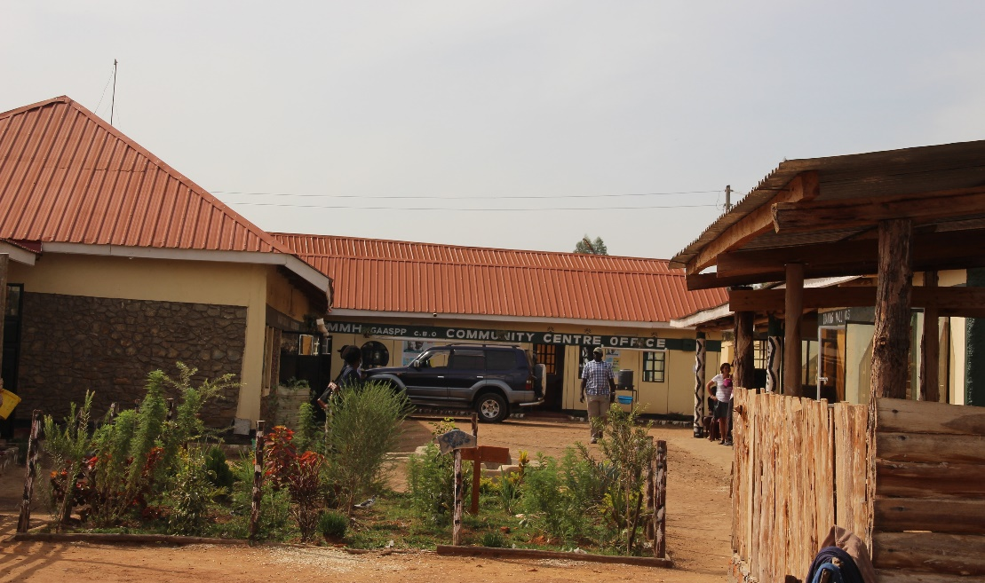
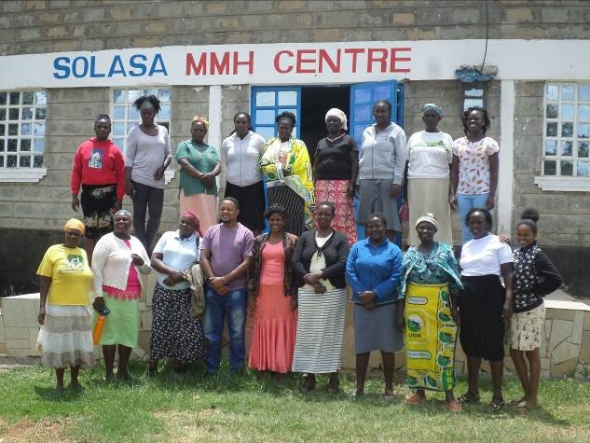
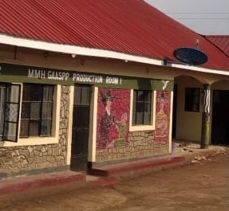
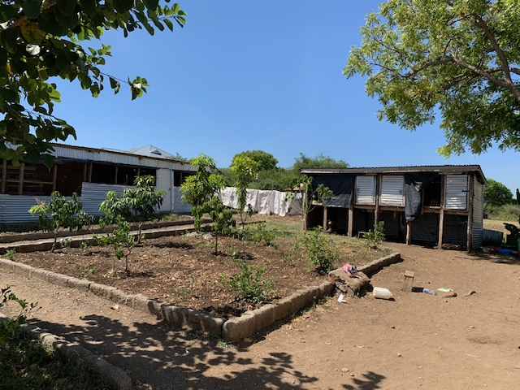
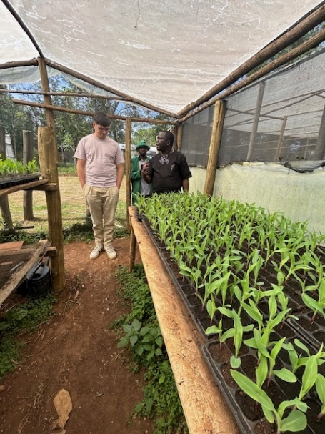
Impressions from our NGO centers in the SCN Kenya network

Slide 8
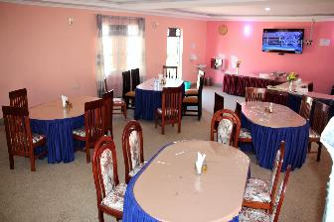


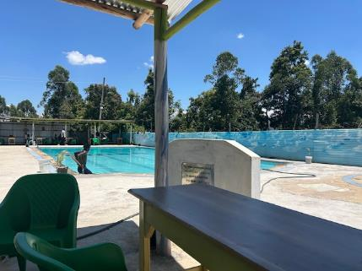
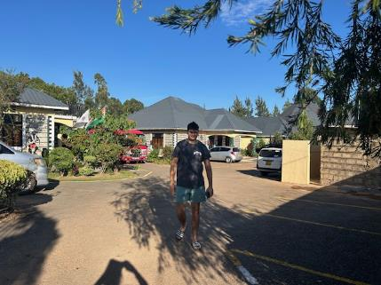
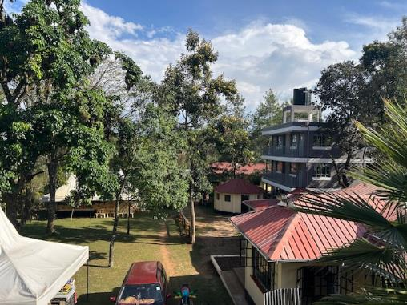
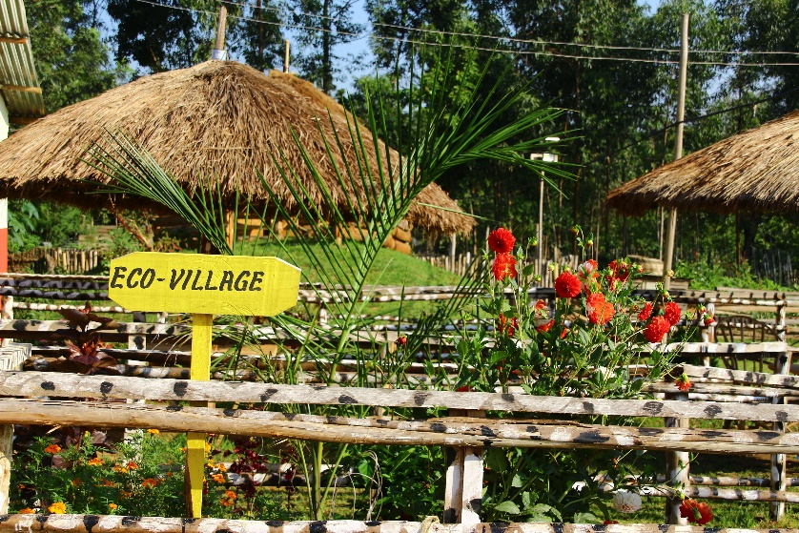
Accommodation
In Tongaren (CHW) and Webuye (GAASPP) we offer our own guesthouses: https://olukuloguesthoue.co.ke, several types of rooms, all with bathroom and good mosquito net
In Kendubay, you will stay in a family.
In Homabay and Eldoret, we offer stays in external guesthouses.
Impressions from our
guesthouses GAASPP
and CHW

Slide 9
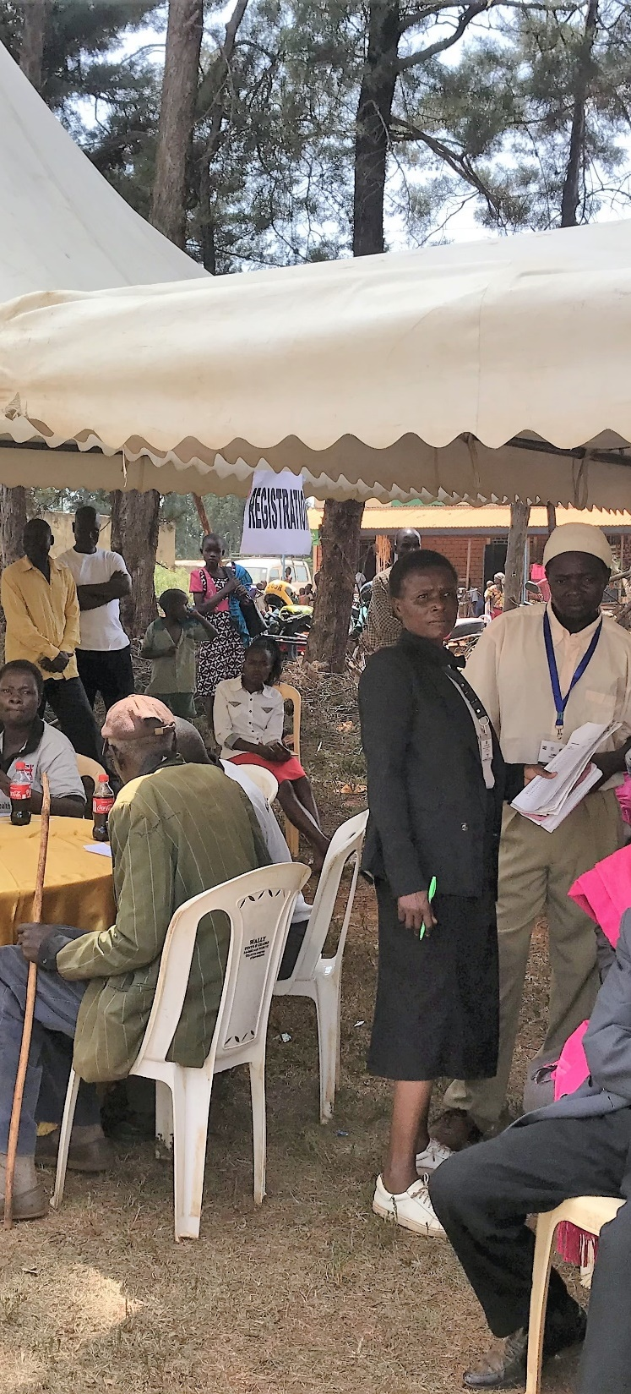
Typical Daily Tasks
Your daily routine will depend on your placement, interests and current projects choose your focus, build your skills, and make a real difference!
Lead community outreach & education sessions—connect, share, and inspire change.
Support local initiatives in health, hygiene, environment, agriculture, culture, and income generation.
Collect & analyze research data—turn insights into action.
Prepare reports & presentations for stakeholders—showcase your impact.
Join team meetings & planning sessions—collaborate, brainstorm, and learn.
Engage with youth & women’s groups—empower and be empowered.
Drive fundraising & awareness campaigns—make your voice count.
Document your experience for project evaluation—your story matters.
Explore new skills—from digital tools to creative projects, every day is different.

Slide 10

How to Propose a New Project Idea
1. Identify a Relevant Topic: Review the focus areas of GAASPP and CHW. Consider local needs, gaps in current projects, or innovative approaches
2. Conduct Background Research: Gather information on the community context, existing projects, and best practices. Consult academic literature, NGO reports, and local stakeholders if possible.
3. Draft a Project Proposal - Your proposal should include:
      Project Title
      Background & Rationale: Why is this project important? What problem does it address?
      Objectives: What do you aim to achieve?
      Planned Activities: What will you do? (e.g., workshops, surveys, training, campaigns)
      Expected Outcomes: What results do you anticipate?
      Timeline: When will each activity take place?
      Resources Needed: Materials, support, budget (if applicable)
      Potential Partners: Who will you work with? (e.g., local groups, other NGOs)
      Evaluation Plan: How will you measure success?
4. Discuss with local Supervisor: Share your draft proposal with your assigned supervisor at GAASPP or CHW. Be open to feedback and ready to adapt your idea to local realities and organizational priorities.
5. Finalize and Submit: Revise your proposal based on feedback. Submit the final version to your supervisor and, if required, your university for approval.

Slide 11
Possible project topics (examples only)
Community/Maternal and Child Health Education: Designing and delivering workshops on hygiene, nutrition basics and daily rituals. Support outreach, data collection, and health promotion.
Water, Sanitation &Hygiene (WASH): Developing/evaluating/training WASH projects in communities/ schools
Sustainable Agriculture: Assisting with demonstration farms, permaculture, or organic farming initiatives.
Youth Empowerment: Organizing activities or training for local youth groups.
Community Empowerment: Supporting specific groups/cooperatives or microfinance initiatives.
Monitoring & Evaluation: Collecting and analyzing data to assess project impact.
Public Relations & Fundraising: Creating awareness campaigns or supporting grant applications.
Digital Literacy: Teaching basic computer skills to community members or NGO staff.
Environmental Conservation: Participating in tree planting, waste management, or biodiversity projects.
System Changer Network Kenya support (www.scn-kenya.org): evaluation, events, website optimization/documentation tasks, communications & promotion

Slide 12
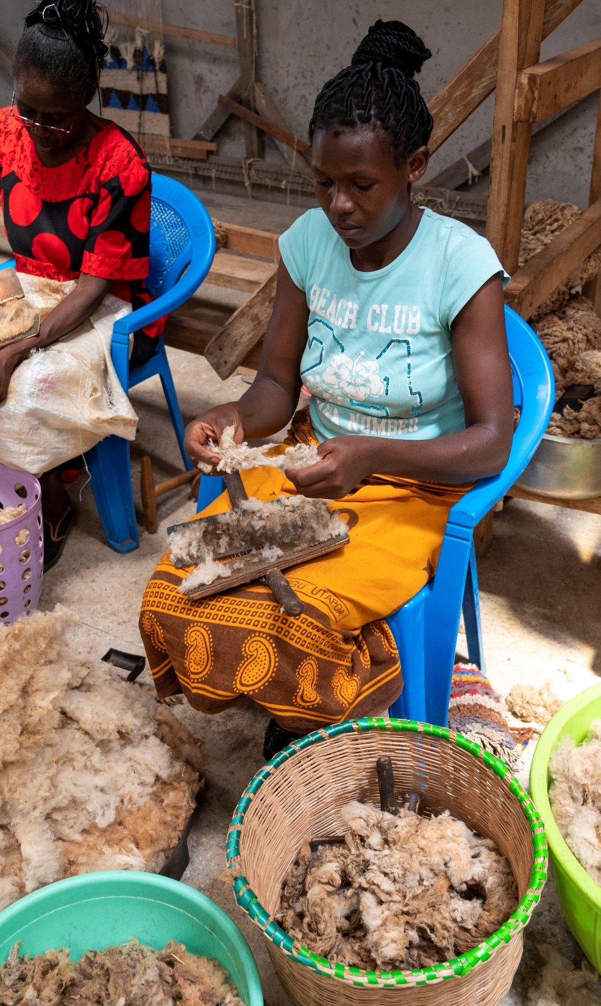
Costs
1 month stay only: 1050 EUR
2-6 months stay: 900 EUR/month. This corresponds to a daily rate of 30 EUR (includes accommodation and three meals per day plus transport costs to project areas).
Pickup/drop off airport: ca. 40 EUR/transport
Additional Costs: Travel, excursions, and visits to other NGOs or safari parks can be arranged at extra cost
E.g.
    Visits to Other NGOs: You may visit other SCN Kenya partner organizations to broaden your perspective. (Daily rate plus transport)
    Excursions: Optional trips to local attractions, including safari parks, can be organized.
    Cultural Immersion: Experience Kenyan culture through community events, local markets, and traditional cuisine.

Slide 13
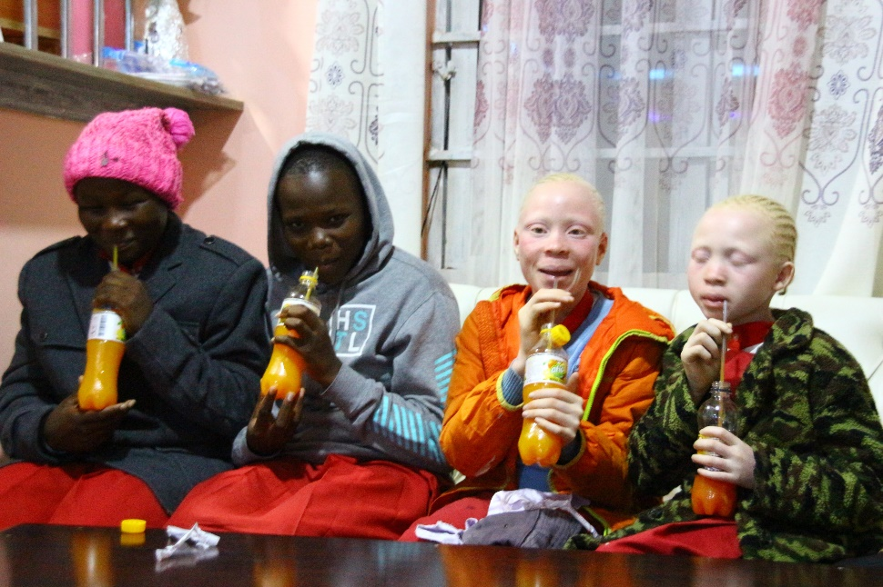
Safety, Support & House rules (extract)
Guidance from Day One: Start with an orientation week and count on ongoing support throughout your stay.
Safe Accommodation/Spaces: Your guesthouse is secure and comfy. Rule #1: Don’t leave the guesthouse after dark. Rule #2: No riding on motorbikes/cars of strangers—your safety comes always first!
Medical Support: Quick access to medical care is available if needed. However, make sure you have a valid and good health insurance coverage for your stay.
Trusted Transport: All our drivers are vetted and experienced, so you can travel safely.
Access to local and international networks and resources, including social entrepreneurs and companies
Always Supported: You’ll have on-site supervision from experienced local staff, plus 24/7 access to your NGO lead if you need anything.

Slide 14
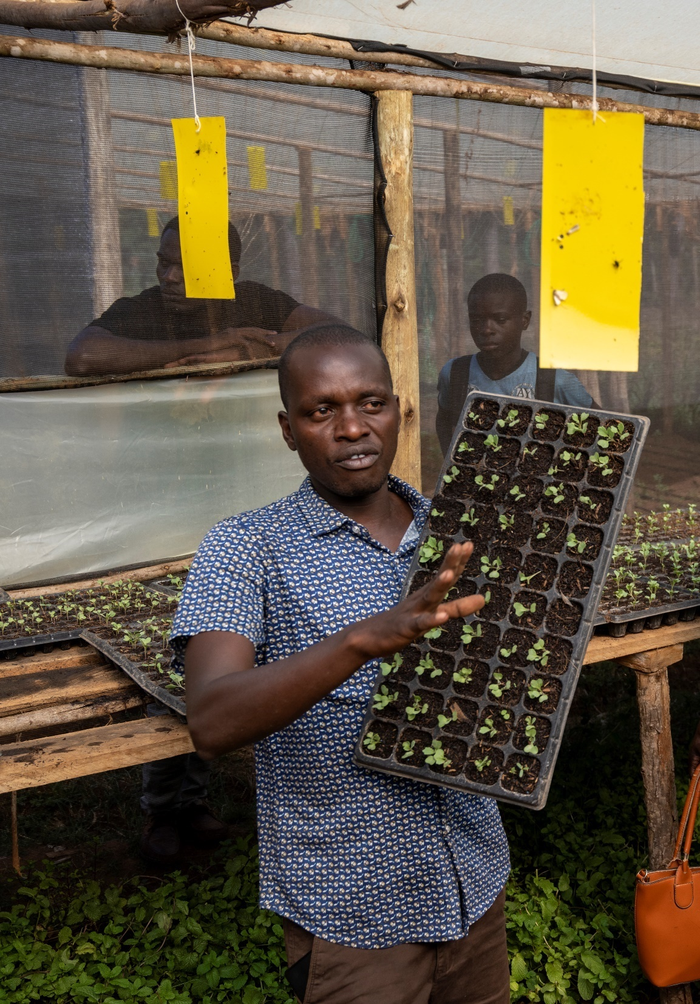
University Contacts
Both GAASPP and CHW maintain active partnerships and contacts with local universities, including:
Moi University, Eldoret
University of Bungoma
University of Eldoret
Kipkemoi University
These connections offer students opportunities for academic exchange, joint research, and networking with Kenyan students and faculty.
Details of collaboration will be defined on request and project type.

Slide 15
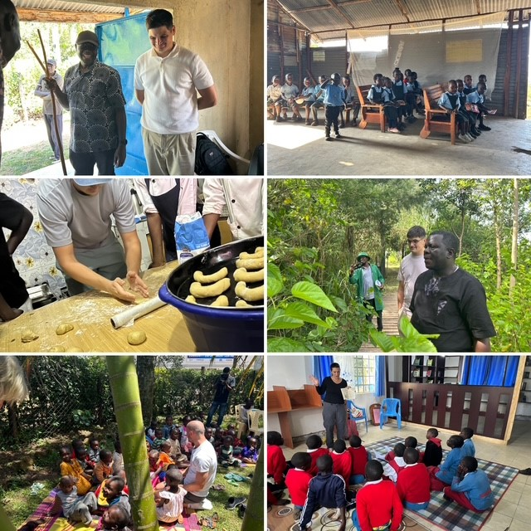
Internship Certificate
At the end of the internship, each participant will receive an official certificate from SCN Kenya, GAASPP, and/or CHW. The certificate will include:
Duration of the internship
Description of main activities and responsibilities
Skills and competencies developed
Project(s) contributed to
Assessment of performance and engagement
This certificate can be used for academic credit recognition or as a valuable addition to your CV.

Slide 16
How to apply
To apply for the program, please prepare and submit the following documents to GAASPP and CHW
(addresses you find in the ppt organizational details)
Curriculum Vitae (CV)
Motivation Letter (explaining your interest, relevant skills, and preferred focus area)
Project Proposal (optional, if you wish to initiate your own project)
Academic Transcript (latest available)
Proof of Enrollment at your university
Reference Letter (from a lecturer or supervisor, if available)
Copy of Passport
Preferred Internship Dates (start and end)
Any Special Requirements (dietary, medical, etc.)

Slide 17
Program timeline
1. Application & Selection (8-2 Months Before Departure)
Submit your CV, motivation letter, reference, and preferred dates
Receive confirmation and placement details
2. Pre-Departure Preparation (1 Month Before Departure)
Attend online info sessions and preparation workshops
Connect with fellow participants and program coordinators
3. Arrival & Orientation (Week 1)
Settle into your guesthouse
Participate in orientation week: safety briefing, local culture, project overview
4. Internship & Volunteering (Weeks 2–12)
Get hands-on with community projects (health, education, agriculture, youth empowerment, etc.)
Weekly team meetings, ongoing guidance, and support
Free weekends for exploration and cultural immersion
5. Special Activities & Excursions (Throughout Stay)
Join excursions (safari, local events, visits to other NGOs)
6. Project Wrap-Up & Evaluation (Final Week)
Present your work and impact
Receive feedback and official internship certificate
7. Departure & Alumni Network
Farewell event
Stay connected with SCN Kenya and fellow changemakers

Slide 18

We look forward to meeting you soon in Kenya!
For any questions, please contact scnkenya@gmail.com and/or pastore.manuela@googlemail.com (SCN Kenya coordinator international)

