Slide 1
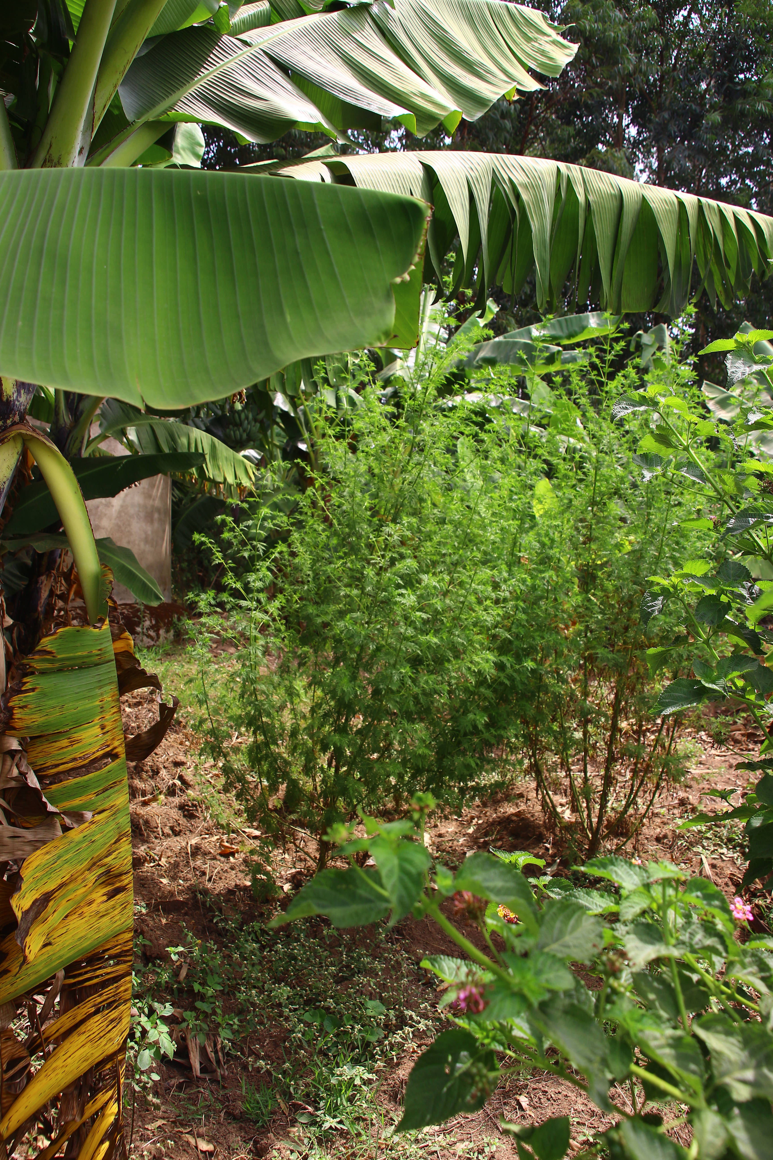
Volunteering Assignment in Webuye, Western Kenya.
SCN Partner organization: GAASPP
Indigenous Reforestation & School Agroforestry Development Volunteer Assignment

Slide 2
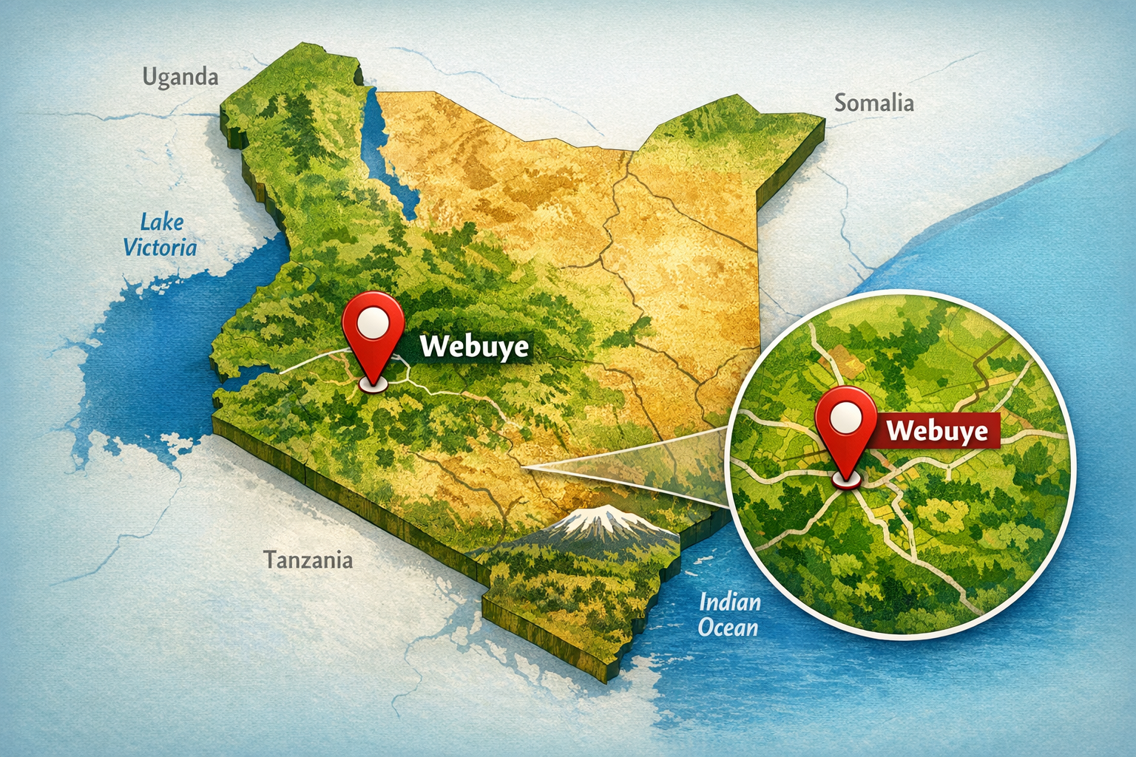
Duration: ca. 4 weeks – 6 weeks onsite, full-time,
(with pre-assignment virtual consult)
Period: now - end of 2026
Location: GAASPP, Webuye, Kenya
Website of our SCN partner in Kenya:
GaasppKenya or https://www.gaasppkenya.org/
GAASPP runs an own guesthouse with an ecovillage, dining hall, ca. 100 rooms and a public swimming pool.

Slide 3
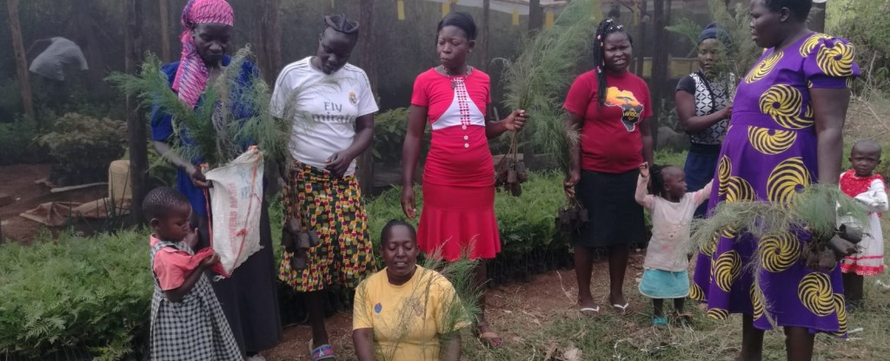
Objective
Establish a technically sound indigenous tree nursery and riverbank restoration system, including a replicable fruit tree program for schools

Slide 4
Scope of Expert Support
Technical design of indigenous tree nursery systems
. Riverbank stabilization planning using native species.
. Design and execution of eco-village Models
. School fruit tree agroforestry model design
. Training community members and teachers on:
Seedling production
Tree spacing and planting techniques
Maintenance and survival rate improvement
Development of monitoring and evaluation tools

Slide 5
Expected Deliverables
Operational tree nursery manual
Riverbank restoration implementation plan
School fruit tree program framework
Training of at least 30 local trainers
Monitoring framework with survival rate tracking.
Functional local Eco-village network plan

Slide 6
Target Beneficiaries
5 riverbank communities, 10 schools
.2,000 indirect beneficiaries in year one in and around Webuye, Western Kenya
Your contributions/materials might be reused in several locations of the SCN Kenya where we we run several demo farms and tree planintg projects, too. Your ideas ad workwill have impact even beyond Kenya in our partner NGOs.

Slide 7
Local Implementation Capacity
During your onsite stay GAASPP commits to:
Local logistics & coordination
Dedicated staff collaboration
Community mobilization
Safe accommodation and 24/7 availability
Your contribution: flights + local costs for accommodation & food

Slide 8
Volunteer Profile
Background & Expertise: A motivated professional with experience in agroforestry systems, ecosystem restoration, or sustainable land management. The volunteer should bring a solid understanding of tree nursery operations, native species propagation, soil conservation, and community‑based environmental programs. Prior exposure to smallholder farming systems, tropical ecology, or nature‑based solutions is an advantage.
Technical Skills: Ability to design and document an operational indigenous tree nursery manual, including species selection, seedling production, watering systems, and maintenance protocols.Knowledge of riverbank stabilization techniques using native species and nature‑based solutions .Experience developing school agroforestry or fruit‑tree programs, ideally with youth engagement or educational components. Capacity to establish monitoring and evaluation frameworks, including survival‑rate tracking, field data collection, and simple reporting tools.Understanding of eco‑village concepts, community resilience models, and rural sustainability planning.
Training & Capacity‑Building Competence: Skilled in delivering hands‑on trainings for farmers, teachers, or community members.Able to train and mentor at least 30 local trainers in seedling production, planting techniques, maintenance, and monitoring.Comfortable working alongside GAASPP staff, local communities, and school partners.Personal QualitiesCulturally sensitive, respectful, and highly adaptable to rural settings in Western Kenya.Self‑driven, solutions‑oriented, and comfortable working in environments with limited resources.Capable of collaborating closely with local NGOs, community leaders, and school staff.Passionate about long‑term environmental impact and community empowerment.

Slide 9
Interested?
Contact us via the SCN website at:
https://scn-kenya.org/contact-us/
The next steps:
Review of your email/application
Call introduction from SCN NGO leader and the applicant

