Slide 1
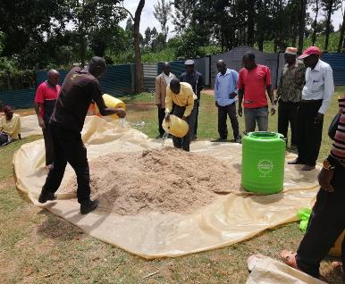
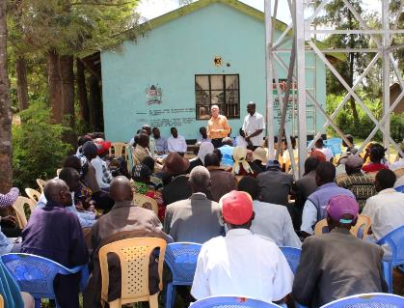

Golden Years, Global Impact: Volunteering in Kenya for 55 +
Manuela Pastore, Feb.‘26
SCN Kenya international coordinator/advisor

Slide 2
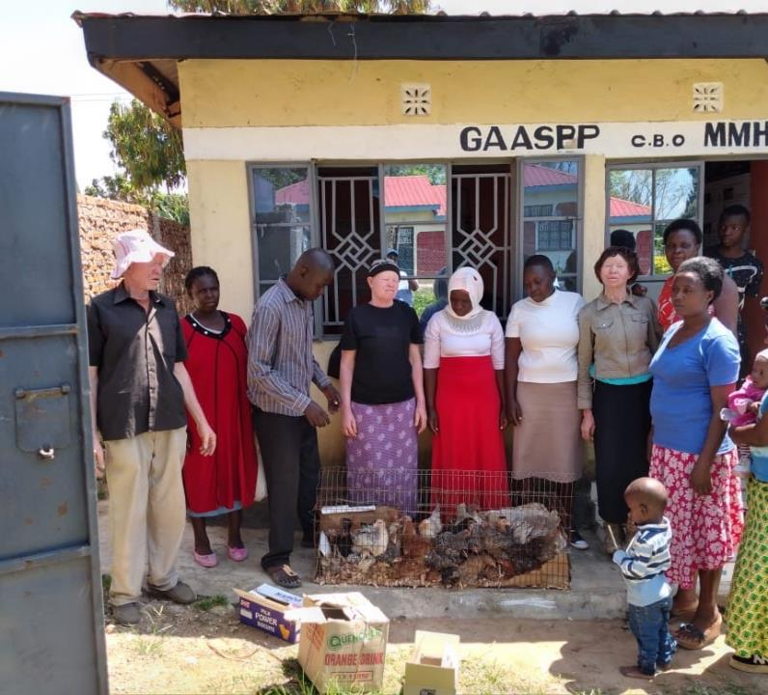
Table of contents
Make an Impact in Kenya- Program overview 1 & 2
Join Kenya’s SCN Movement & network
Where can you volunteer?
Impressions from our NGO centers
Accommodation
What Will Your Days Look Like?
Safety, Support & House rules
Costs
Internship Certificate
How to apply
Exchange Program timeline
Organizational details
Contact/Info

Slide 3
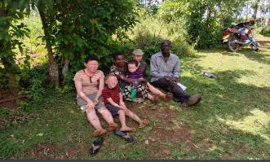

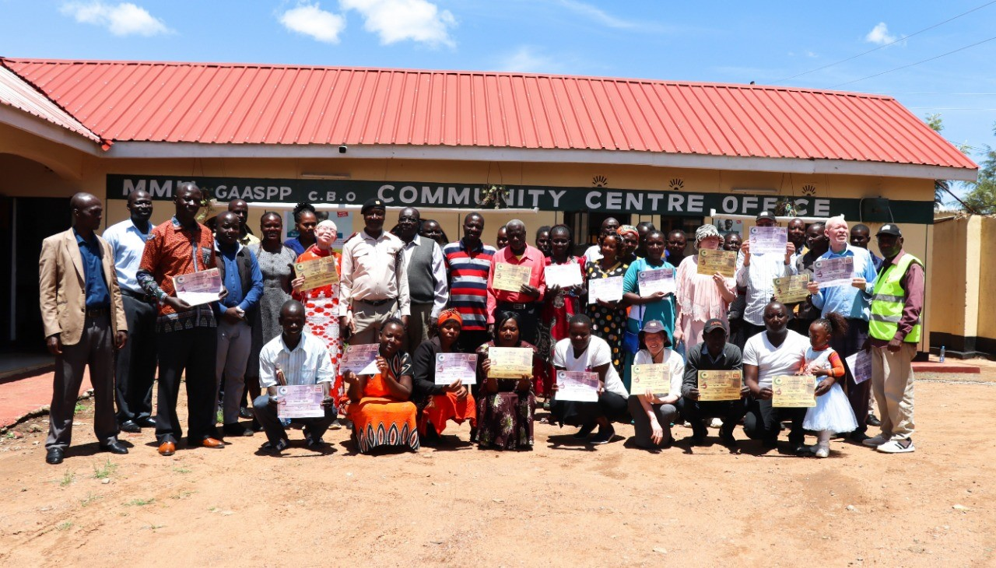
Make an Impact in Kenya - Program overview, 1
Begin Your Kenyan Adventure
Are you 55 years + and ready for a meaningful journey abroad? The SCN Kenya Volunteering Exchange Program welcomes you to make a real difference through hands-on community work in Western Kenya.
Purposeful Internships
Collaborate with local communities through internships at two impactful NGOs—GAASPP and CHW International. Contribute to positive change in health, education, agriculture, and environmental initiatives.
Flexible Placements
Select an internship duration that suits your lifestyle—from two weeks up to three months. Personalize your experience to match your interests and availability.
Personal Growth
Develop new skills, expand your network, and gain practical experience working alongside dedicated professionals and local youth.
Cultural Exchange
Immerse yourself in Kenyan culture, build friendships, and broaden your perspective through authentic learning and teamwork.

Slide 4

Program Overview, 2
Before You Go:
Take part in a deep dive online workshop and introductory calls designed to help you prepare for your journey. Get all your questions answered and connect with fellow volunteers.
While in Kenya:
Work side-by-side with experienced local NGO professionals, community members, teachers, and other stakeholders.
Make a real impact by contributing to meaningful projects, while developing valuable skills in project management, teamwork, and cross-cultural communication.
Enjoy Your Free Time:
Weekends are yours to relax, explore, or deepen your connection with Kenyan culture.
Explore More:
Expand your experience by visiting other NGOs within the SCN Kenya network. Join optional excursions, such as safari park visits (additional costs apply), and immerse yourself in local traditions and activities.
A Life-Changing Opportunity:
This is your chance to travel, learn, and be part of something bigger—creating unforgettable memories and making a meaningful difference.

Slide 5

Join Kenya’s Sustainable Collaboration Network & movement
Become Part of a Network Driving Real Change
Join SCN Kenya, a vibrant alliance of local NGOs and international partners working together WITH vulnerable communities for a more holistic regional change for better. Your exchange is anchored by GAASPP and CHW—two of seven core organizations—connecting you to the entire network.
Founded in 2022, SCN Kenya empowers vulnerable communities across Kenya, especially those at or below the poverty line. The network supports about 1 million people from Nairobi’s informal settlements to Lake Victoria and from Western Kenya to Mombasa.
SCN Kenya thrives on partnerships (SDG 17), innovation, and transforming and connecting global ideas into local solutions. Through teamwork, creative problem-solving, and social entrepreneurship, you’ll help drive sustainable, community-rooted development.
Join us to learn, grow, and help shape new solutions to big challenges.
Ready to be part of a movement that matters? https://www.scn-kenya.org

Slide 6
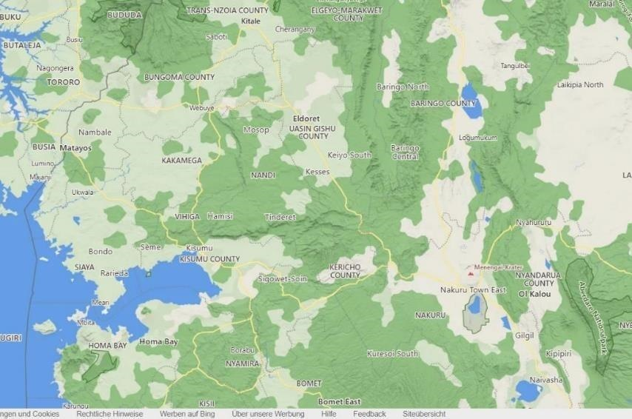
Where you can volunteer?
CHW,
Tongaren
Depending on your interest, we offer 5 NGO core partners in Western Kenya who can host you:
Core Health & Wealth (CHW)
Golden aged and albinism support project program (GAASPP)
Solasa
Wa-Wa Kenya
Tendo
(For more details see organisational part)
Ca. 57 km,
By car ca 70 min
Airport,
Eldoret
Solasa,
Eldoret
GAASPP,
Webuye
Tendo,
Kendubay
Airport Kisumu
Wa-Wa Kenya , Homabay
-> Nairobi

Slide 7
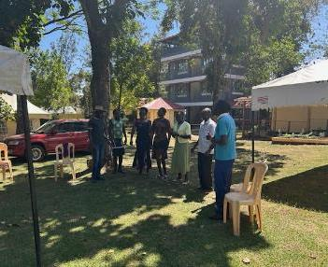
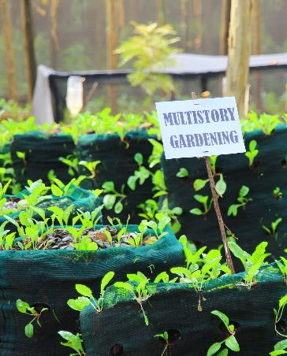
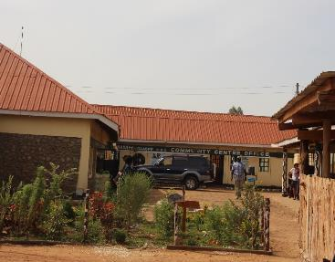
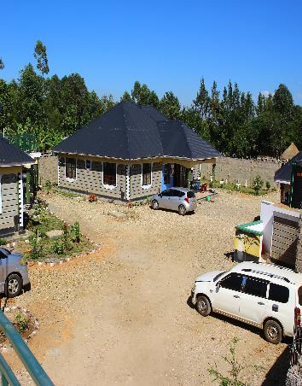
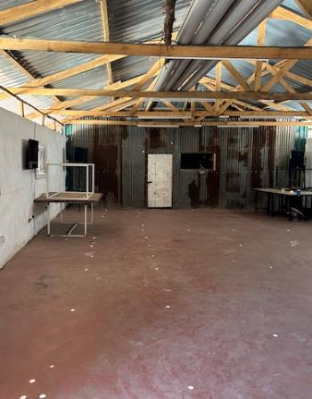



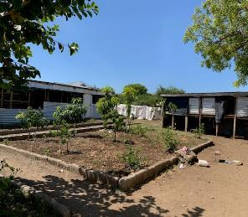
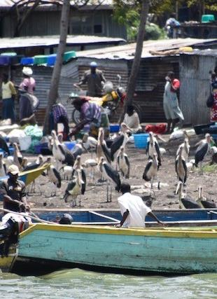
Our core SCN Kenya centers available for volunteering
GAASPP, Webuye
Center and Olukulu guesthouse
V.I.C.C.O, Mukuru
slums, Nairobi
Core Health & Wealth, Tongaren
Wa-Wa Kenya, Homabay
SOLASA, Eldoret, Langas slums
Tendo, Kendubay

Slide 8



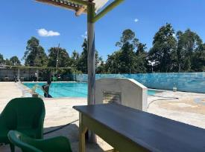
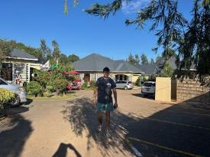
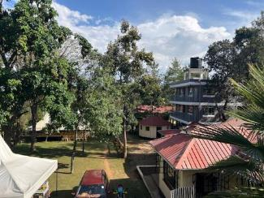
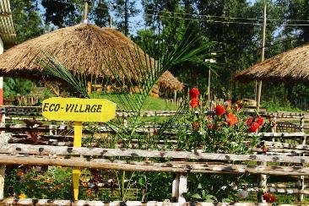
Accommodation
In Tongaren (CHW) and Webuye (GAASPP) we offer our own guesthouses: https://olukuloguesthoue.co.ke, several types of rooms, all with bathroom and good mosquito nets.
In Kendubay, you will stay in a family.
In Homabay and Eldoret, we offer stays in external guesthouses. Costs around 35 EUR/room/day.
Impressions from our
guesthouses at the NGO GAASPP
and NGO CHW

Slide 9

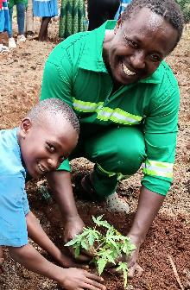
What Will Your Days Look Like? Every day is different!
Contribute Your Expertise: Apply your professional skills—whether in engineering, health promotion, production, or other fields—to specific projects where your experience can make a real impact, e.g.
Community & Education: Teach, connect, share, and make a real impact.
Sustainable Agriculture/Environment: Get hands‑on in demo farms and run practical training workshops. Join tree planting, waste management, and conservation efforts.
Digital Empowerment: Teach digital skills to locals and NGO teams; support social media, filming, and event organization.
Research & Data: Collect and analyze data, document your experience, and create reports/presentations that drive decisions.
Teamwork & Leadership: Participate in team meetings and planning sessions; engage youth and women’s or men ‘s groups—empower others.
Creativity & Campaigns: Share your talents (from guitar to handicrafts) and run awareness & fundraising campaigns

Slide 10
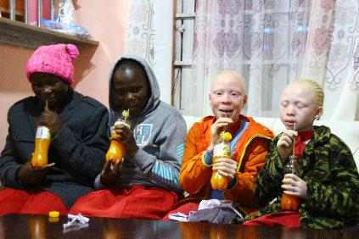
Safety, Support & House rules
(extract)
Always Supported: You’ll have on-site supervision from experienced local staff, plus 24/7 access to your NGO lead if you need anything.
Safe Accommodation/Spaces: Your guesthouse is secure and comfy. Rule #1: Don’t leave the guesthouse after dark. Rule #2: No riding on motorbikes/cars of strangers—your safety comes first!
Medical Support: Quick access to medical care is available if needed. However, make sure you have a valid and good health insurance coverage for your stay.
Guidance from Day One: Start with an orientation week and count on ongoing support throughout your stay.
Trusted Transport: All our drivers are vetted and experienced, so you can travel safely.

Slide 11
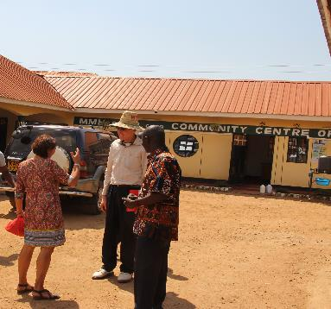

Costs
Minimum is a 2 Weeks stay: 800 EUR
Every additional week: 350 EUR
For a stay longer than 2 months extra conditions may apply.
These costs include intro phase, accommodation and three meals per day) plus local transport costs to the project areas
Pickup/drop off airport: ca. 50 EUR/transport
Additional Costs: Travel, excursions, and visits to other NGOs or safari parks can be arranged at extra cost. E.g.
    Visits to Other NGOs: You may visit other SCN Kenya partner organizations to broaden your perspective. (Daily rate plus transport)
    Excursions: Optional trips to local attractions, including safari parks, can be organized.
    Cultural Immersion: Experience Kenyan culture through community events, local markets, and traditional cuisine.

Slide 12

Internship Certificate
At the end of the internship, you will receive an official certificate from SCN Kenya, GAASPP, and/or CHW. The certificate will include:
Duration of the internship
Description of main activities and responsibilities
Skills and competencies developed
Project(s) contributed to
Assessment of performance and engagement
This certificate can be used as a valuable addition to your CV.

Slide 13
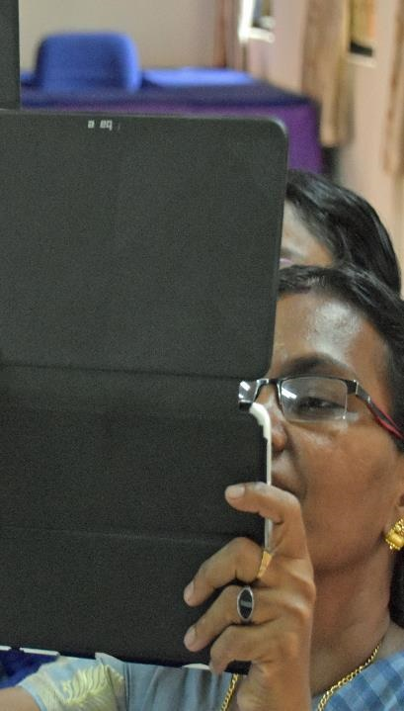
How to apply
To apply for the program, please prepare and submit the following documents to GAASPP and CHW (addresses you find in the ppt organizational details)
Curriculum Vitae (CV)
Motivation Letter (explaining your interest, relevant skills, and preferred focus area)
Reference Letter (from a lecturer or supervisor, if available)
Copy of Passport
Preferred Internship Dates (start and end)
Any Special Requirements (dietary, medical, etc.)

Slide 14
Exchange Program procedure & timeline
1. Application & Selection (8-2 Months Before Departure)
Submit your CV, motivation letter, and preferred dates
Receive confirmation and placement details
2. Pre-Departure Preparation (1 Month Before Departure)
Attend online info sessions and preparation workshops
Connect with fellow participants and program coordinators
3. Arrival & Orientation (Week 1)
Settle into your guesthouse
Participate in orientation week: safety briefing, local culture, project overview
4. Internship & Volunteering (Weeks 2–12)
Get hands-on with community projects & activities
Weekly team meetings, ongoing guidance, and support
Free weekends for exploration and cultural immersion
5. Special Activities & Excursions (Throughout Stay)
Join excursions (safari, local events, visits to other NGOs)
6. Project Wrap-Up & Evaluation (Final Week)
Present your work and impact
Receive feedback and official internship certificate
7. Departure & Alumni Network
Farewell event
Stay connected with SCN Kenya and fellow changemakers

Slide 15


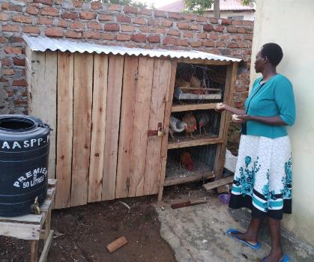
We look forward to meeting you soon in Kenya!
For any questions, please contact scnkenya@gmail.com or via our website: https://scn-kenya.org

